Slide 1
Esti-Mystery
By: Isaac Green

Slide 2
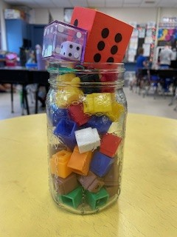
Cube attack
How many building cubes are in the jar

Slide 3
Clue 1
The answer is between the product of 5 times 4 and 90
Clue 2
The answer is a prime number
Clue 3
The answer does not include the digits 1 and 7
Clue 4
The ones place in the answer does not include the answer to 5+4

Slide 4
THE REVEAL:
53
PICTURE

