Slide 1
Get Ready…
We’re going to NAME our MULTIPLICATION facts!

Slide 2
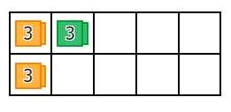
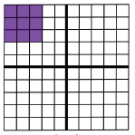
3 x 3 = 9

Slide 3
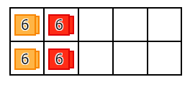
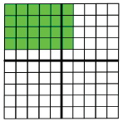
4 x 6 = 24

Slide 4
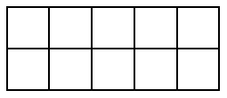
0 x 7 = 0

Slide 5
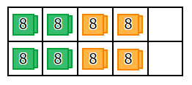
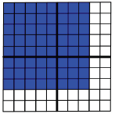
8 x 8 = 64

Slide 6
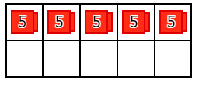
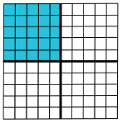
5 x 5 = 25

Slide 7
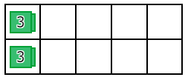
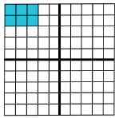
2 x 3 = 6

Slide 8
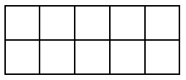
0 x 5 = 0

Slide 9
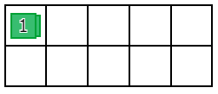
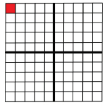
1 x 1 = 1

Slide 10
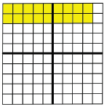
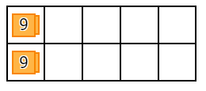
2 x 9 =18

Slide 11
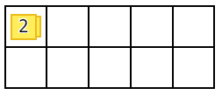
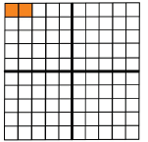
1 x 2 = 2

Slide 12
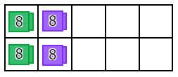
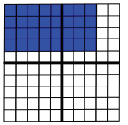
4 x 8 = 32

Slide 13
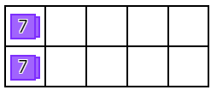
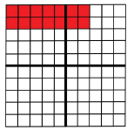
2 x 7 = 14

Slide 14
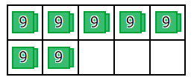
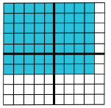
7 x 9 = 63

Slide 15
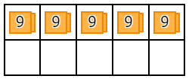
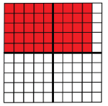
5 x 9 = 45

Slide 16
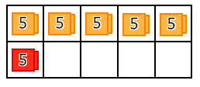
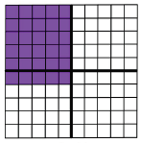
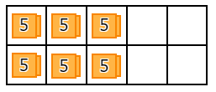
6 x 5 = 30
OR

Slide 17
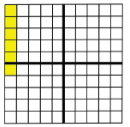
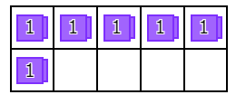
6 x 1 = 6

Slide 18
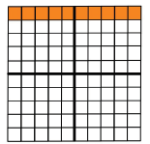
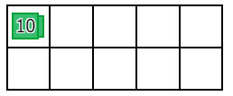
1 x 10 = 10

Slide 19
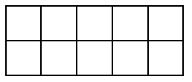
4 x 0 = 0

Slide 20
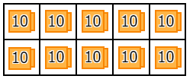
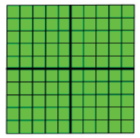
10 x 10 = 100

Slide 21
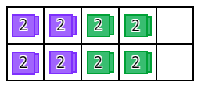
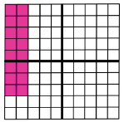
8 x 2 = 16

Slide 22
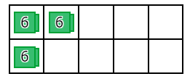
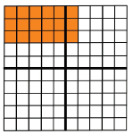
3 x 6 = 18

Slide 23
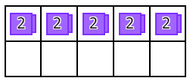
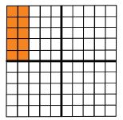
5 x 2 = 10

Slide 24
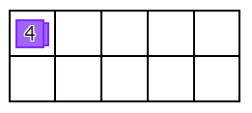
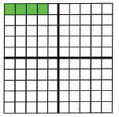
1 x 4 = 4

Slide 25
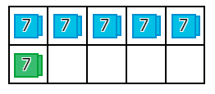
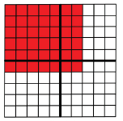
6 x 7 = 42

Slide 26
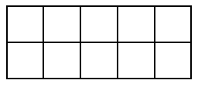
0 x 2 = 0

Slide 27
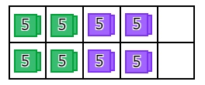
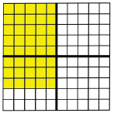
8 x 5 = 40

Slide 28
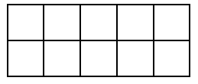
0 x 3 = 0

Slide 29


1 x 5 = 5

Slide 30


7 x 7 = 49

Slide 31


3 x 9 = 27

Slide 32

0 x 1 = 0

Slide 33


3 x 5 = 15

Slide 34


7 x 8 = 56

Slide 35


3 x 8 = 24

Slide 36


10 x 8 = 80

Slide 37

0 x 6 = 0

Slide 38


2 x 10 = 20

Slide 39


9 x 1 = 9

Slide 40


2 x 2 = 4

Slide 41


8 x 1 = 8

Slide 42


4 x 9 = 36

Slide 43


6 x 8 = 48

Slide 44


10 x 9 = 90

Slide 45


6 x 6 = 36

Slide 46


5 x 10 = 50

Slide 47


9 x 9 = 81

Slide 48


3 x 1 = 3

Slide 49


4 x 7 = 28

Slide 50


7 x 10 = 70

Slide 51


4 x 5 = 20

Slide 52


7 x 5 = 35

Slide 53

0 x 10 = 0

Slide 54


8 x 9 = 72

Slide 55
8 x 0 = 0

Slide 56


4 x 4 = 16

Slide 57


10 x 6 = 60

Slide 58


4 x 3 = 12

Slide 59
0 x 0 = 0

Slide 60


2 x 4 = 8

Slide 61


4 x 10 = 40

Slide 62


3 x 10 = 30

Slide 63


6 x 9 = 54

Slide 64


7 x 1 = 7

Slide 65
0 x 9 = 0

Slide 66


3 x 7 = 21

Slide 67
Get Ready…
We’re going to NAME our DIVISION facts!

Slide 68


80 ÷ 10 = 8
80
10 x ? = 80

Slide 69


28 ÷ 7 = 4
28
7 x ? = 28

Slide 70


5 ÷ 1 = 5
5
1 x ? = 5

Slide 71


35 ÷ 7 = 5
35
7 x ? = 35

Slide 72


7 ÷ 7 = 1
7
7 x ? = 7

Slide 73


72 ÷ 9 = 8
72
9 x ? = 72

Slide 74


56 ÷ 8 = 7
56
8 x ? = 56

Slide 75


10 ÷ 1 = 10
10
1 x ? = 10

Slide 76


9 ÷ 9 = 1
9
9 x ? = 9

Slide 77


42 ÷ 6 = 7
42
6 x ? = 42

Slide 78


3 ÷ 3 = 1
3
3 x ? = 3

Slide 79

63 ÷ 9 = 7
63
9 x ? = 63

Slide 80

49 ÷ 7 = 7
49
7 x ? = 49

Slide 81

12 ÷ 3 = 4
12
3 x ? = 12

Slide 82


12 ÷ 6 = 2
12
6 x ? = 12

Slide 83


0 ÷ 10 = 0
0
10 x ? = 0

Slide 84

36 ÷ 6 = 6
36
6 x ? = 36

Slide 85

32 ÷ 8 = 4
32
8 x ? = 32

Slide 86


14 ÷ 2 = 7
14
2 x ? = 14

Slide 87

3 ÷ 1 = 3
3
1 x ? = 3

Slide 88

27 ÷ 3 = 9
27
3 x ? = 27

Slide 89


16 ÷ 4 = 4
16
4 x ? = 16

Slide 90

0 ÷ 9 = 0
0
9 x ? = 0

Slide 91


35 ÷ 5 = 7
35
5 x ? = 35

Slide 92

27 ÷ 9 = 3
27
9 x ? = 27

Slide 93

24 ÷ 8 = 3
24
8 x ? = 24

Slide 94

36 ÷ 4 = 9
36
4 x ? = 36

Slide 95

24 ÷ 3 = 8
24
3 x ? = 24

Slide 96

9 ÷ 3 = 3
9
3 x ? = 9

Slide 97

30 ÷ 5 = 6
30
5 x ? = 30

Slide 98

20 ÷ 10 = 2
20
10 x ? = 20

Slide 99

0 ÷ 8 = 0
0
8 x ? = 0

Slide 100

8 ÷ 4 = 2
8
4 x ? = 8

Slide 101

18 ÷ 2 = 9
18
2 x ? = 18

Slide 102

45 ÷ 9 = 5
45
9 x ? = 45

Slide 103

0 ÷ 7 = 0
0
7 x ? = 0

Slide 104

12 ÷ 4 = 3
12
4 x ? = 12

Slide 105

90 ÷ 10 = 9
90
10 x ? = 90

Slide 106

4 ÷ 2 = 2
4
2 x ? = 4

Slide 107

40 ÷ 10 = 4
40
10 x ? = 40

Slide 108

50 ÷ 10 = 5
50
10 x ? = 50

Slide 109

32 ÷ 4 = 8
32
4 x ? = 32

Slide 110

0 ÷ 6 = 0
0
6 x ? = 0

Slide 111

9 ÷ 1 = 9
9
1 x ? = 9

Slide 112

30 ÷ 3 = 10
30
3 x ? = 30

Slide 113

6 ÷ 1 = 6
6
1 x ? = 6

Slide 114

20 ÷ 4 = 5
20
4 x ? = 20

Slide 115

0 ÷ 5 = 0
0
5 x ? = 0

Slide 116

40 ÷ 8 = 5
40
8 x ? = 40

Slide 117

1 ÷ 1 = 1
1
1 x ? = 1

Slide 118

70 ÷ 10 = 7
70
10 x ? = 70

Slide 119

50 ÷ 5 = 10
50
5 x ? = 50

Slide 120

0 ÷ 4 = 0
0
4 x ? = 0

Slide 121

30 ÷ 10 = 3
30
10 x ? = 30

Slide 122

25 ÷ 5 = 5
25
5 x ? = 25

Slide 123

20 ÷ 2 = 10
20
2 x ? = 20

Slide 124

15 ÷ 5 = 3
15
5 x ? = 15

Slide 125

0 ÷ 3 = 0
0
3 x ? = 0

Slide 126

2 ÷ 2 = 1
2
2 x ? = 2

Slide 127

15 ÷ 3 = 5
15
3 x ? = 15

Slide 128

16 ÷ 2 = 8
16
2 x ? = 16

Slide 129

16 ÷ 8 = 2
16
8 x ? = 16

Slide 130

10 ÷ 10 = 1
10
10 x ? = 10

Slide 131

0 ÷ 2 = 0
0
2 x ? = 0

Slide 132

64 ÷ 8 = 8
64
8 x ? = 64

Slide 133

54 ÷ 6 = 9
54
6 x ? = 54

Slide 134

100 ÷ 10 = 10
100
10 x ? = 100

Slide 135

8 ÷ 1 = 8
8
1 x ? = 8

Slide 136

4 ÷ 1 = 4
4
1 x ? = 4

Slide 137

80 ÷ 8 = 10
80
8 x ? = 80

Slide 138

10 ÷ 5 = 2
10
5 x ? = 10

Slide 139

0 ÷ 1 = 0
0
1 x ? = 0

Slide 140

56 ÷ 7 = 8
56
7 x ? = 56

Slide 141

2 ÷ 1 = 2
2
1 x ? = 2

Slide 142

63 ÷ 7 = 9
63
7 x ? = 63

Slide 143

18 ÷ 6 = 3
18
6 x ? = 18

Slide 144

7 ÷ 1 = 7
7
1 x ? = 7

Slide 145

5 ÷ 5 = 1
55
5 x ? = 5

Slide 146

4 ÷ 4 = 1
4
4 x ? = 4

Slide 147

24 ÷ 6 = 4
24
6 x ? = 24

Slide 148

70 ÷ 7 = 10
70
7 x ? = 70

Slide 149

40 ÷ 5 = 8
40
5 x ? = 40

Slide 150

40 ÷ 4 = 10
40
4 x ? = 40

Slide 151

24 ÷ 4 = 6
24
4 x ? = 24

Slide 152

8 ÷ 8 = 1
8
8 x ? = 8

Slide 153

21 ÷ 3 = 7
21
3 x ? = 21

Slide 154

8 ÷ 2 = 4
8
2 x ? = 8

Slide 155

18 ÷ 9 = 2
18
9 x ? = 18

Slide 156

42 ÷ 7 = 6
42
7 x ? = 42

Slide 157

6 ÷ 2 = 3
6
2 x ? = 6

Slide 158

14 ÷ 7 = 2
14
7 x ? = 14

Slide 159

28 ÷ 4 = 7
28
4 x ? = 28

Slide 160

21 ÷ 7 = 3
21
7 x ? = 21

Slide 161

81 ÷ 9 = 9
81
9 x ? = 81

Slide 162

12 ÷ 2 = 6
12
2 x ? = 12

Slide 163

60 ÷ 10 = 6
60
10 x ? = 60

Slide 164

6 ÷ 3 = 2
6
3 x ? = 6

Slide 165

45 ÷ 5 = 9
45
5 x ? = 45

Slide 166

60 ÷ 6 = 10
60
6 x ? = 60

Slide 167

90 ÷ 9 = 10
90
9 x ? = 90

Slide 168

20 ÷ 5 = 4
20
5 x ? = 20

Slide 169

48 ÷ 6 = 8
48
6 x ? = 48

Slide 170

18 ÷ 3 = 6
18
3 x ? = 18

Slide 171

30 ÷ 6 = 5
30
6 x ? = 30

Slide 172

72 ÷ 8 = 9
72
8 x ? = 72

Slide 173

54 ÷ 9 = 6
54
9 x ? = 54

Slide 174

48 ÷ 8 = 6
48
8 x ? = 48

Slide 175

6 ÷ 6 = 1
6
6 x ? = 6

Slide 176

36 ÷ 9 = 4
36
9 x ? = 36

Slide 177

10 ÷ 2 = 5
10
2 x ? = 10

Slide 178

Way to go!

